Slide 1


BRICK PLAN Infra Associates
Home About Services Team Projects Contact

Slide 2
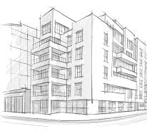
BRICK PLAN Infra Associates
Home About Services Team Projects Contact
About
We provide engineering, architectural and Urban Planning consulting services for planning and design to both public and private sector Clients, in a timely, cost effective and innovative manner while providing quality and responsive services by a highly qualified professionals. We provides a broad spectrum of professional consulting services, allowing us to serve our Clients during each phase of a project, including advance/preliminary planning services, design and construction oversight.

Slide 3
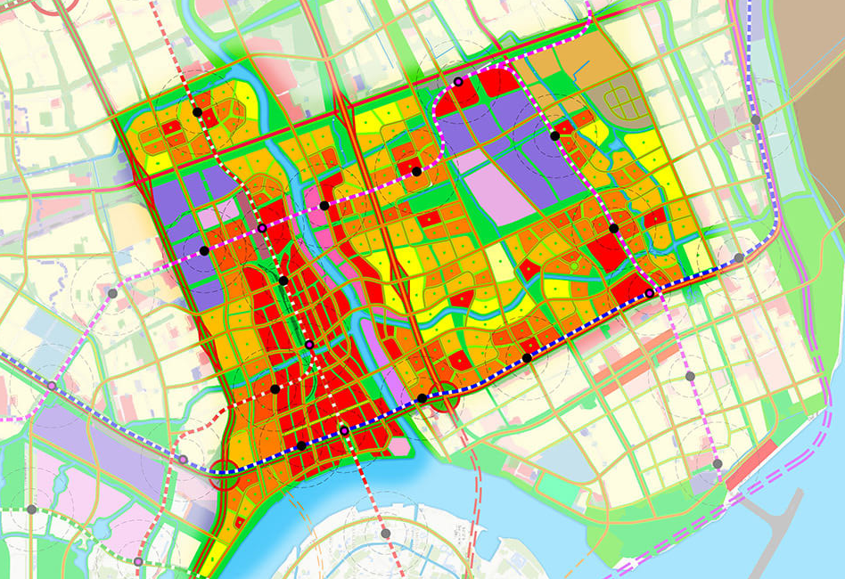
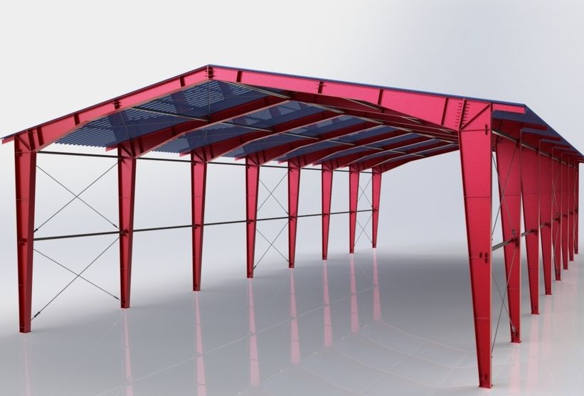
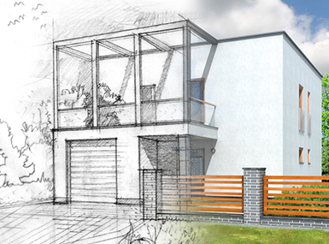
BRICK PLAN Infra Associates
Home About Services Team Projects Contact
What We Do
Engineering
Architecture
Planning
Structural Design for Residential Buildings, Industrial Sheds
Electrical & Plumbing drawings
Roads design
Water Supply & UGD
Irrigation
Land Surveying
Soil Investigation
Estimations & Approvals
Architectural drawings for Residential, Commercial, Institutional & Industrial
Floor Plans
Working drawings
Interior Design
Exterior Design
3D Views
Landscape Design
Residential Layout
Industrial Layouts
Master Plans
Transportation Planning
Junction Improvement
Infrastructure Development

Slide 4
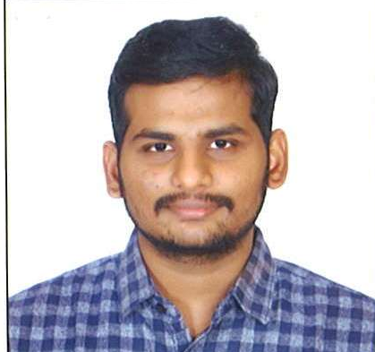



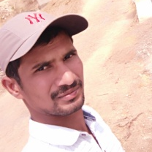
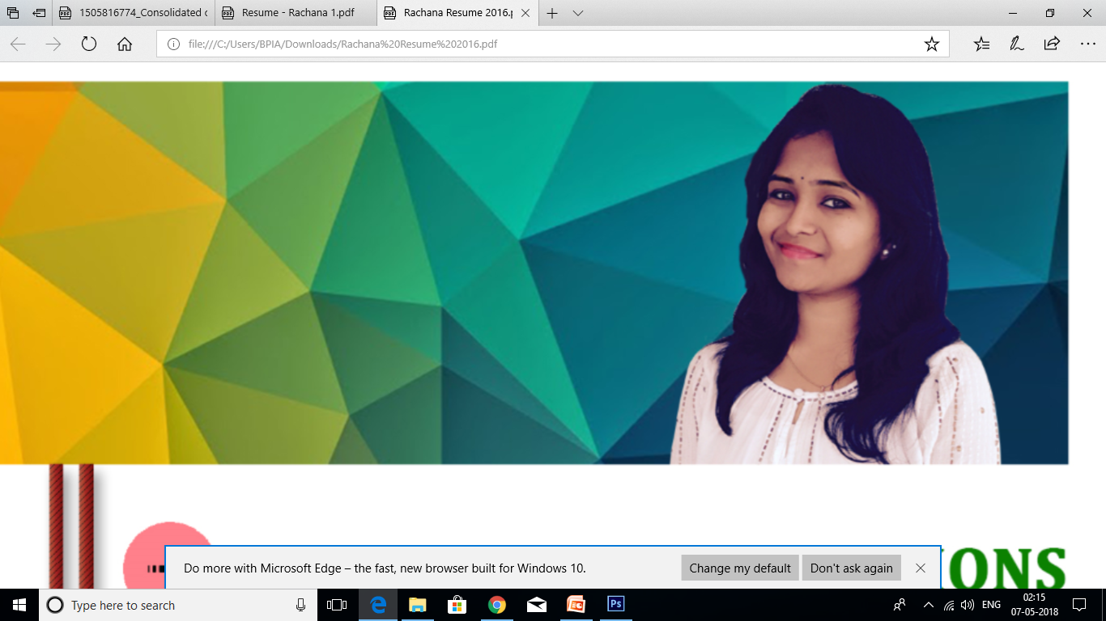
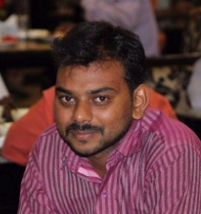
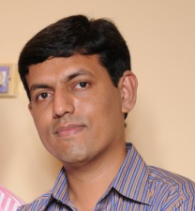
BRICK PLAN Infra Associates
Home About Services Team Projects Contact
Out Team
Anwesh Sirimalla
AITP, GHMC Lic. Engineer
M.Tech (Planning), B.Tech (Civil Engineering)
Vamsi Krishna Telugu
Engineer, Admin
M.Tech (Geo Tech), B.Tech (Civil Engineering)
Akhilesh Rayannagari
GHMC Lic. Engineer
B.Tech (Civil Engineering)
Shiva Vottikoti
Structural Engineer
M.Tech (Structural), B.Tech (Civil Engineering)
Sridhar Kummari
Estimations
M.Tech (Transport), B.Tech (Civil Engineering)
Rachana Chanda
Architect, COA
M.Tech (Planning), B.Arch
Ravi Teja
Estimations
B.Tech (Civil Engineering)
Hayath Ahmed
Licensed Structural Engineer
M.Tech (Structures), B.Tech (Civil Engineering)

Slide 5







BRICK PLAN Infra Associates
Home About Services Team Projects Contact
Out Clients

Slide 6
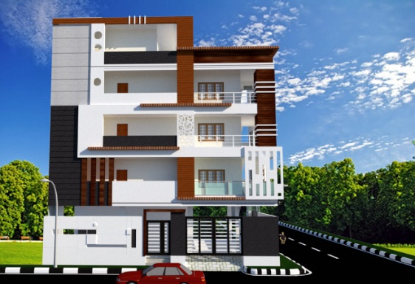
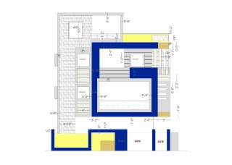
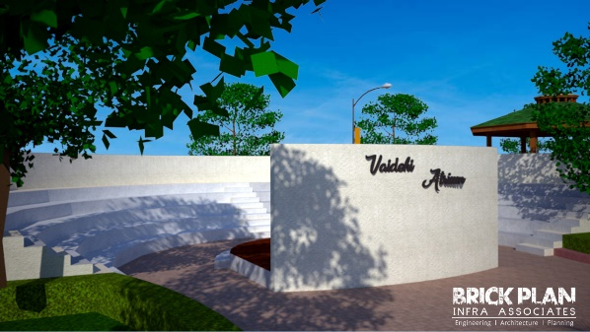
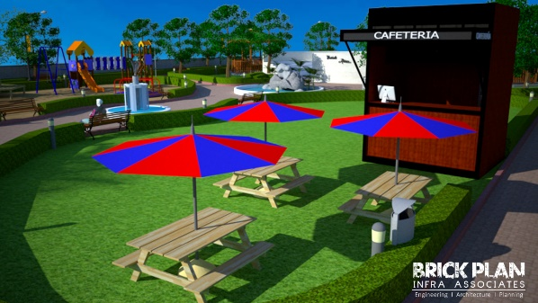
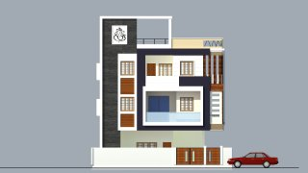
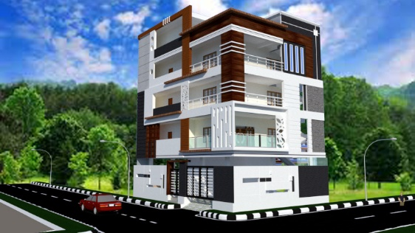
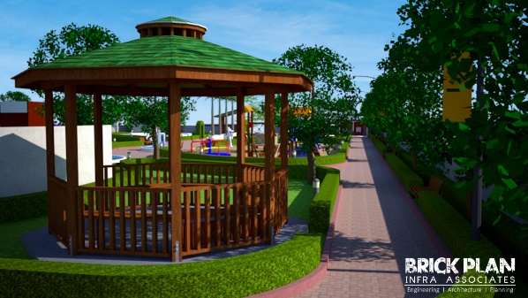
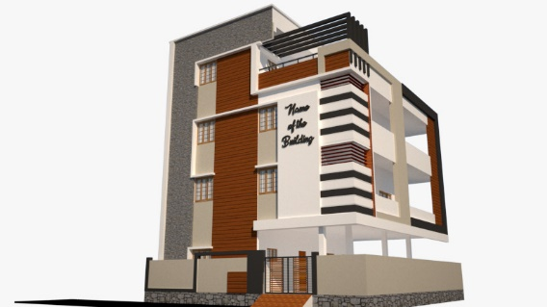
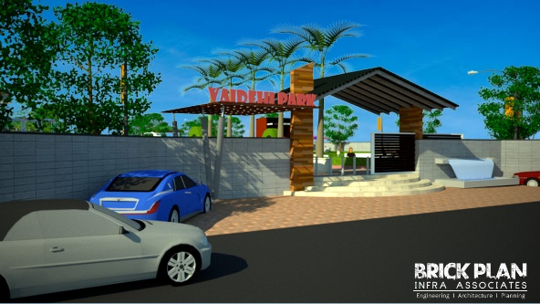
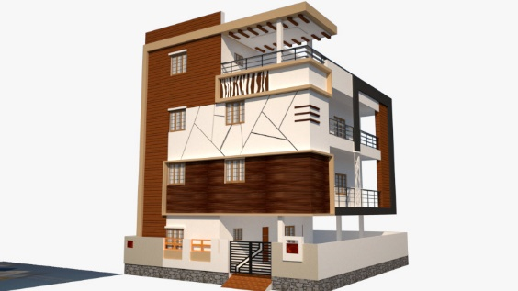
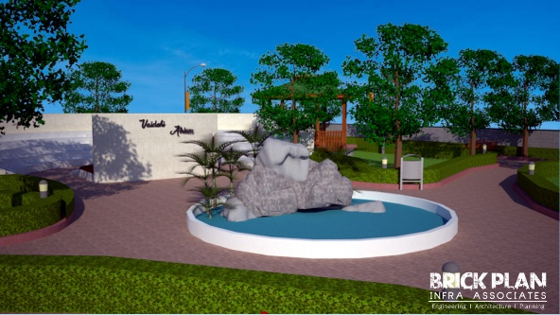
BRICK PLAN Infra Associates
Home About Services Team Projects Contact
Out Projects

Slide 7
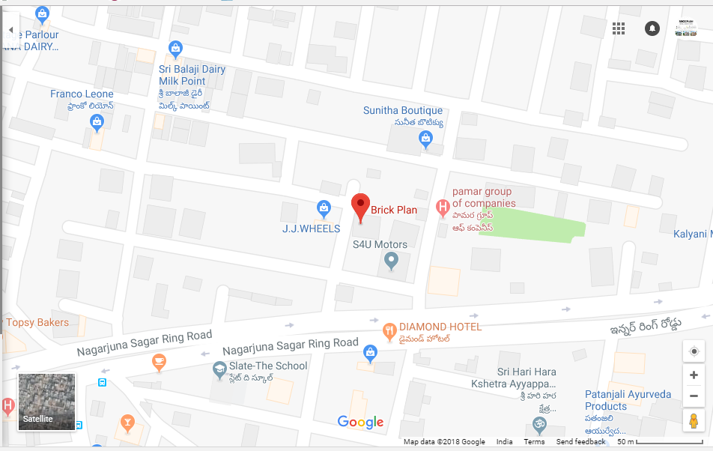



Contact
9553307082 l 9154944123
brickplanconsultants@gmail.com
# 301, Manti Mansion, Defence Colony, Karmanghat, Hyderabad

